Slide 1
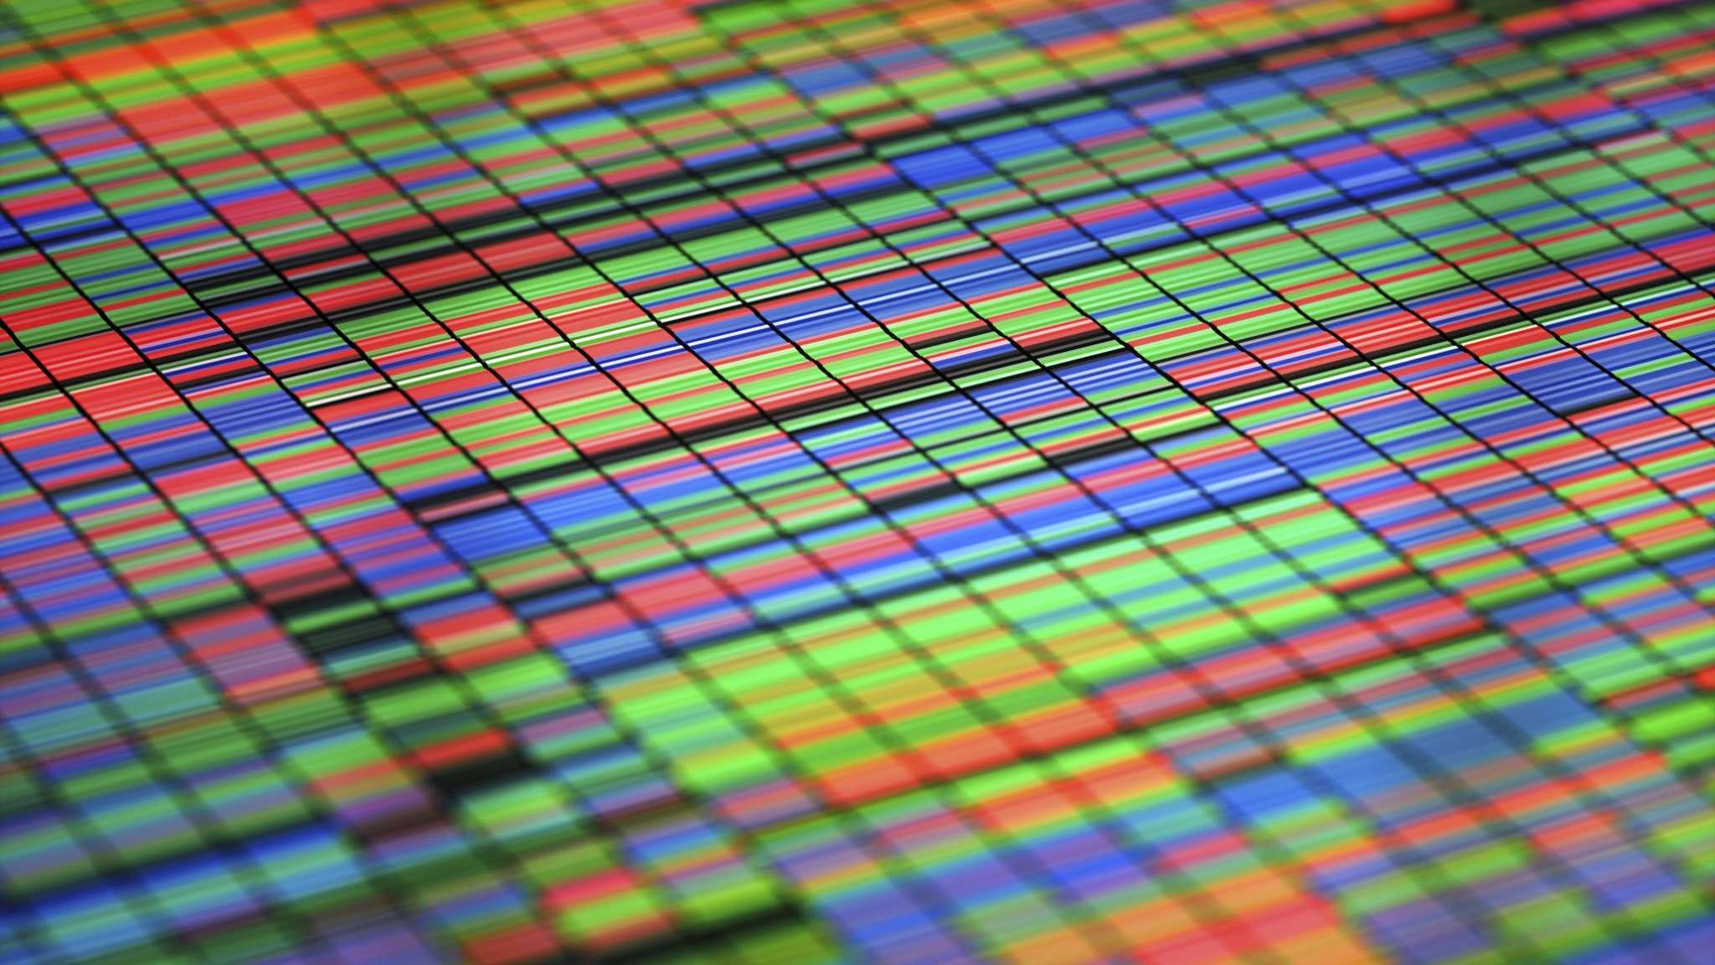
Atari Breakout using Deep Q-Learning
Team – Perfect Dealers
K.Vishnu Sainadh – BL.EN.U4AIE19028
K.Satwik - BL.EN.U4AIE19034
V.Ashrith - BL.EN.U4AI19066

Slide 2
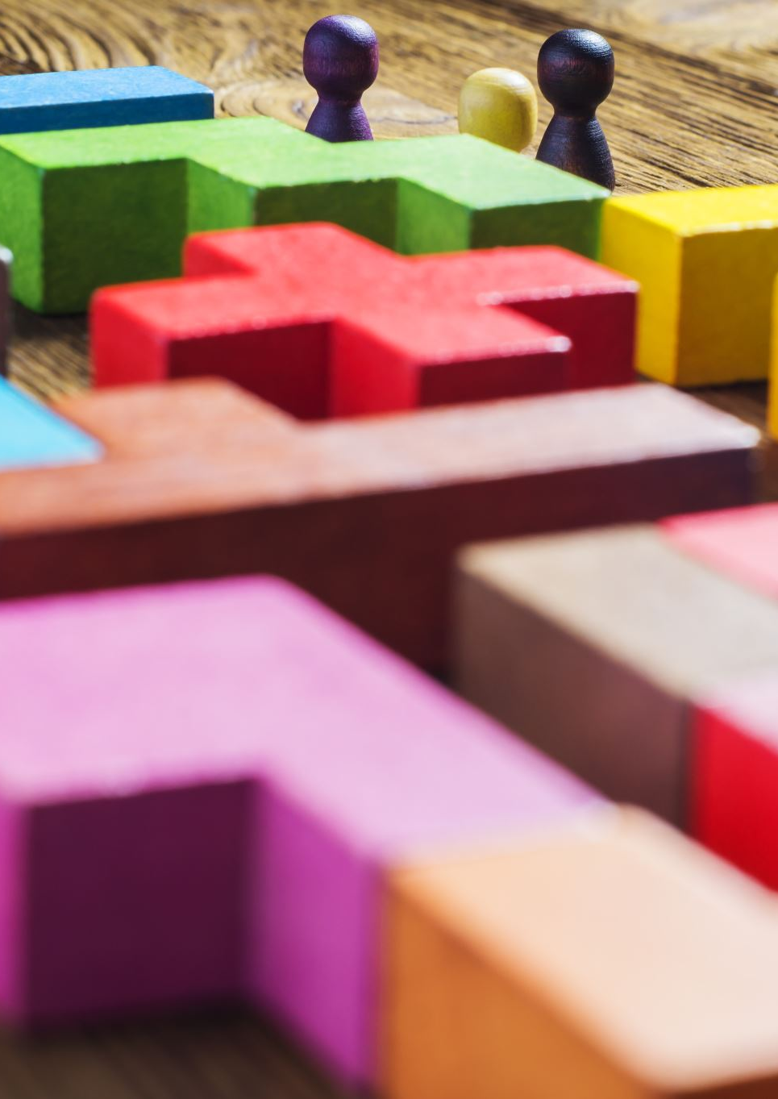
Problem Statement
To implement an AI to play Atari Breakout using Deep-Q-Learning
Goals :
To complete the game of breakout
To minimize the time to complete the game
Notes:
so our task was to create an ai that's
able to play atari breakout on an
emulator using deep q learning
our first
goal is to complete a game of breakout
our second goal is to minimize the time
it takes to complete the game

Slide 3

Agenda
Why choose Atari Breakout?
Applying Deep Q-Learning
Challenges and Problems
Results and Takeaways
What is deep q learning ?
Notes:
just a quick overview of what our presentation is going to be about, first we will go over why we chose atari breakout and then what is deep q learning then how we actually apply deep q learning to our project the challenges and problems we faced and then finally our results and takeaways

Slide 4
Why choose Atari Breakout?
Notes:
about our motivation for choosing this project
a lot of us have been playing atari
breakout ever since we were a kid and it is
a very popular atari game

Slide 5
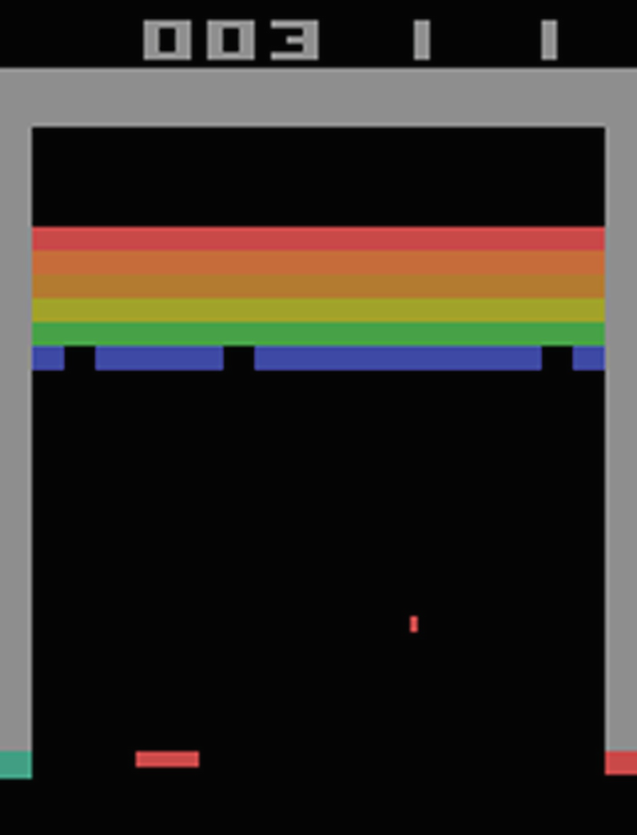
Atari Breakout
Simple controls
Clear Objective
Defined Rewards
Notes:
so in this game there's a lot of a
layer of bricks I.e.,there are bricklines on the top one
third of the screen and the goal is to
destroy them all by repeatedly bouncing
a ball off of a paddle, this game is rather
simple game, there is not very much
complications to it and the action space
is not huge

Slide 6
RL Formulation
Agent : Deep Q-Network(DQN)
States : A Stack of four consecutive grey scale images
Actions : Four discrete actions
NOOP – no operation
FIRE – shoots the ball off the peddle
LEFT – moves the paddle left
RIGHT – moves the paddle right
Rewards : +1 for hitting the bricks and 0 in all other cases
Notes:
Coming to RL formulation

Slide 7
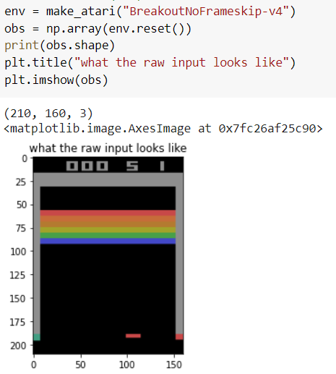
OpenAI Gym
Provides controllable game environments with a python interface
Includes Atari games
Notes:
we are going to use the openai gym library
which provides a lot of environments for
actually simulating different games the atari
game breakout is actually in there so it gives
us a really nice interface where we can focus
on uh the q learning algorithm rather
than uh actually implementing

Slide 8
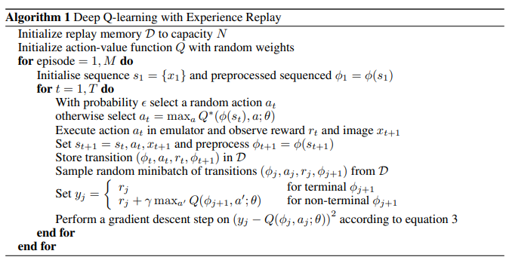
Literature survey
DeepMind
Playing Atari with Deep Reinforcement Learning
Notes:
As part of our literature survey We have reviewed a paper named "playing Atari with deep reinforcement learning " by deep mind where they have implemented DQN on 6 different atari games

Slide 9
Deep Q-Learning
Combines the concept of Reinforcement Learning and Deep Neural Networks
In our project the state is a stack of four consecutive grey scale images
The current reward of a state and the expected reward from taking an action are combined in a weighted algorithm to create a q value of each action.
The action with the highest q value will be the one taken at that step in the game and this process repeats for the entire game
Notes:
let's define deep q learning.it combines
concepts from reinforcement learning and
deep neural networks to decide what action
an agent should take in the environment.
in our project the state is an rgb image
of the game at a given frame
the current reward of a state and the
expected reward from taking an action
are combined in a weighted algorithm to
create a q value of each action
the action with the highest q value will
be the one taken at that step in the
game and this process repeats for the
entire game

Slide 10
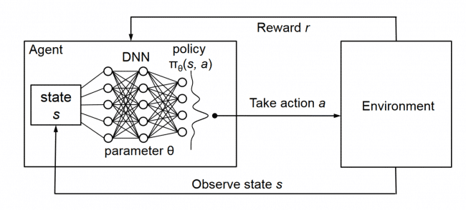
System Architecture
Notes:
as you can see from the picture we have an
environment here we observe the state, pass
the state through the network calculate the
reward and based off that reward take an
action in the environment and this process
repeats

Slide 11
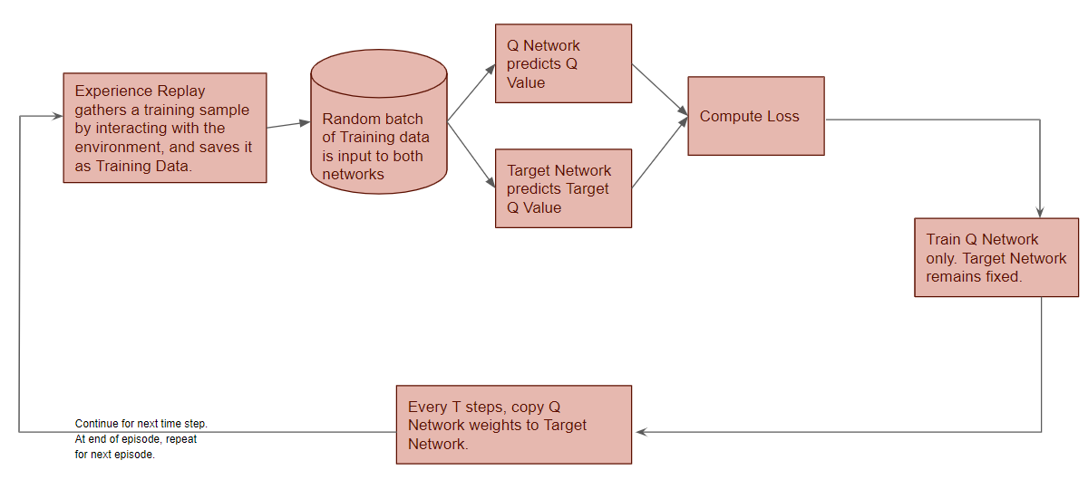
Optimizing the neural network
Notes:
so to optimize the neural network we
first have to store an experience replay
that will contain states rewards actions
and q values from the environment
this experience replay is vital for
training but cannot hold all past data
since it will take up too much memory
and we we will use two identical neural
networks in architecture but with
different weights one to predict the q
values and another to predict the target
q value
the experience replay is sampled to
create a batch of data to train on this
batch is then passed through the q
network and the target network and their
outputs are compared to compute loss the
q network is trained with back
propagation every time loss is computed
and at their predetermined number of
steps in the environment the weights
from the q network are copied over to
the target network

Slide 12
Q-Learning vs Deep Q-Learning
Q-Learning
Handles small and discrete environments
Maintains a table that maps state-action pairs to a q-value
Deep Q-Learning
Handles continuous actions and states
Determines q-value through a neural network
Notes:
the main difference is the method in
which q values are calculated for every
state action pair in normal q learning
a q value table for every state action
pair is maintained so it maps each state
action pair to a q value
whereas in deep q learning
we estimate q values with a neural network
so normal q learning can handle small
and discrete environments better whereas
deep q learning can handle continuous
actions and states
and in environments with infinite state
action pairs it's not feasible to
maintain a q value table so that's where
deep q learning solves this problem

Slide 13
Applying Deep Q-Learning

Slide 14
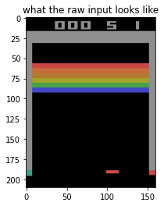
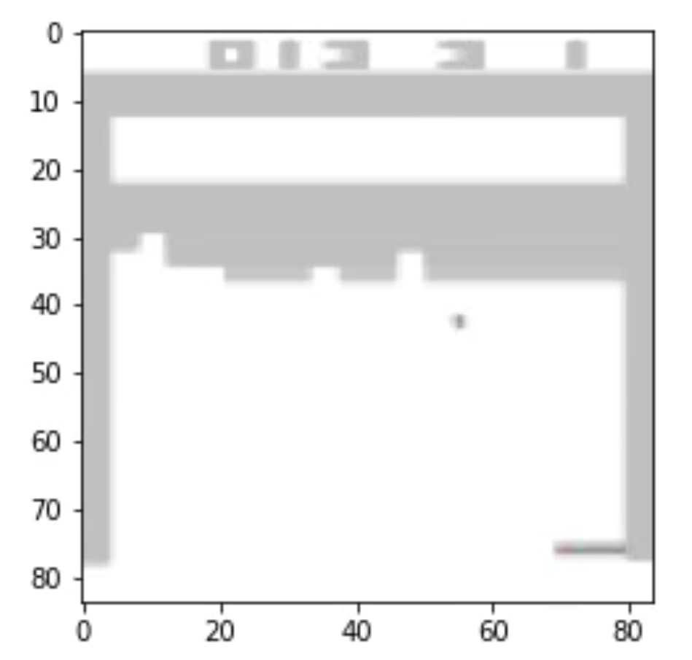
Pre-processing
Original RGB Image of size 210x160x3
Gray-scaled and Cropped
Processed Grey image of size 84x84x1
Original
Grey Scale
Notes:
we are using only images of the game being
played as our input to the q learning
algorithm so we are getting raw images
from the game actually being played and
we are going to process those. The images of
game that are being played are 210*160*3
they are rgb image inputs and we're going to
pre-process them to gray grayscale and cropped
version of them and then we are going to reduce
the size of the image

Slide 15
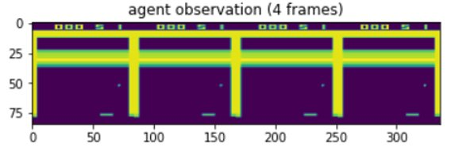
Pre-processing for simulating motion
Its almost impossible to get the velocity and acceleration from a still image of a ball in motion
We can show previous frames to simulate motion
We preprocess the Atari frames further by stacking previous frames further by stacking previous frames such that it has a shape of (84x84x4)
Notes:
if we have a ball that is in air we
just take a still image of a ball in
motion we can't know if it's going up
down left or right that was a previous
problem we were having when training the
reinforcement learning agent. so by stacking
the four images together in a satck as a single
state
in the model and the convolutional layers
actually extracts the relative position of all
the balls and is able to find out the velocity
of the ball

Slide 16
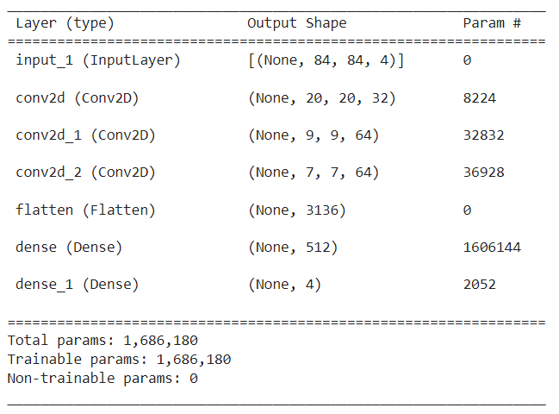
DL Implementation
CNN( Convolution Neural Network)
Model makes the predictions for Q-values which are used to make an action.

Slide 17
Hyperparameters
Gamma
Epsilon
Maximum steps per episode
Replay memory buffer
Update Frequency
Target network update interval
Learning rate
Mini Batch Size
Notes:
Discount factor gamma is used in Q-learning update.
For epsilon we have two values initial value and final value
Maximum steps of an episode.
Replay memory buffer : Size of the previous calculated transitions
Mini batch size : Size of batch taken from replay buffer used for updating weights.
The frequency with which the model is trained.
The frequency with which the target network is updated.

Slide 18
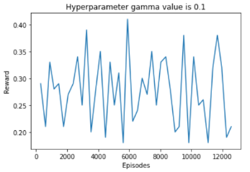
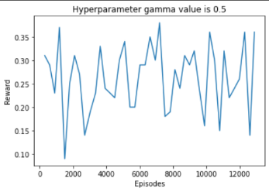
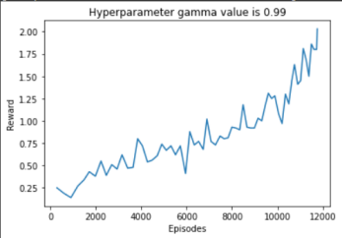
Hyperparameter - Gamma
Hyperparameter value of 0.99 gives us the best results

Slide 19
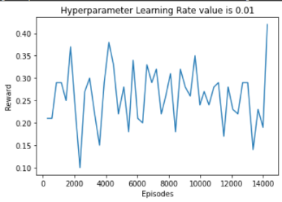
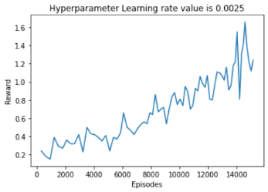
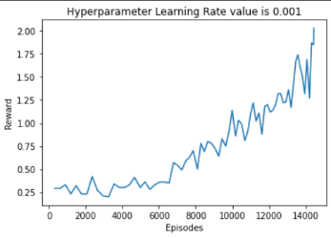
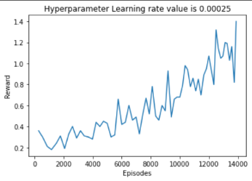
Hyperparameter – Learning Rate
Hyperparameter value of 0.001 gives us the best results

Slide 20
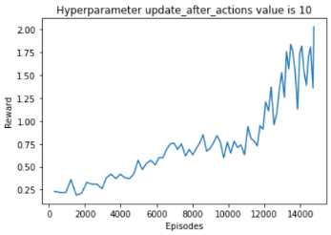
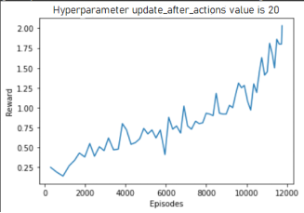
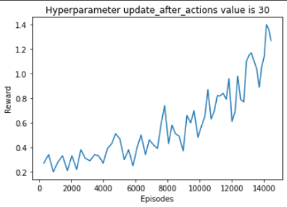
Hyperparameter – Update Frequency
Hyperparameter value of 10 gives us the best results

Slide 21
Challenges and problems
Replay Buffer problem
Random sampling from replay buffer
Network trained on still images
Solution
Group observations in a stack of 4 frames
GPU
For efficient computation GPU is required

Slide 22
Results and Future Scope
We have successfully implemented DQN
Our model can be further modified to work on all Atari environments
Notes:
in general we trained the final model for
over 2 hours and the model was still
not efficient as possible with more training
time we believe this model can perform better.
our future goal was to use the same
model to play other games on the atari
2600 just like they do in the deepmind paper

Slide 23
References
https://towardsdatascience.com/deep-q-learning-tutorial-mindqn-2a4c855abffc
https://towardsdatascience.com/reinforcement-learning-explained-visually-part-5-deep-q-networks-step-by-step-5a5317197f4b

Slide 24
Thank you

